Slide 1
Automatic Trivia Fact Extraction from Wikipedia
Qiancheng Li, Aniket Bonde
Under Supervision of Prof. Ruihong Huang

Slide 2
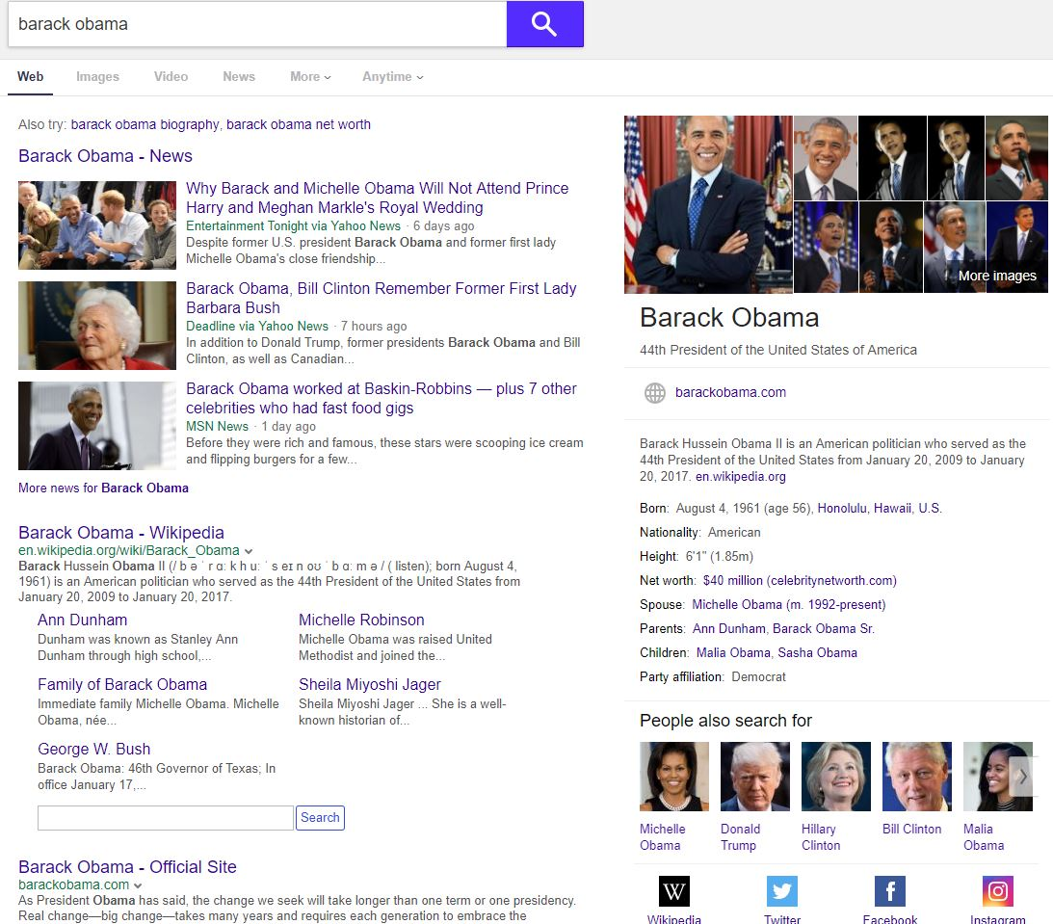
Motivation
Web Search is now an exploratory activity
Improving engagement is a key goal
Most queries are entity related

Slide 3
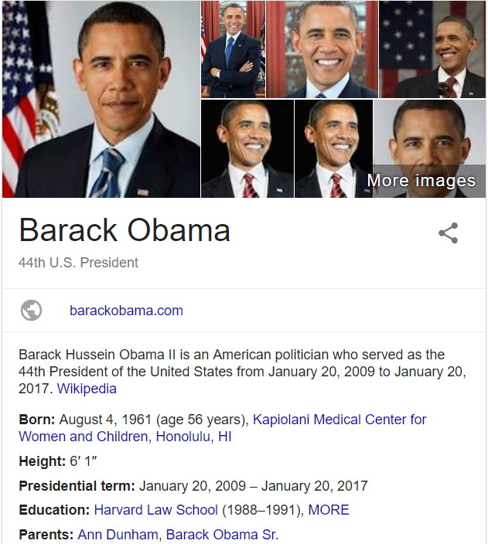

The Contribution
Did you know? Grammy Award winner

Slide 4
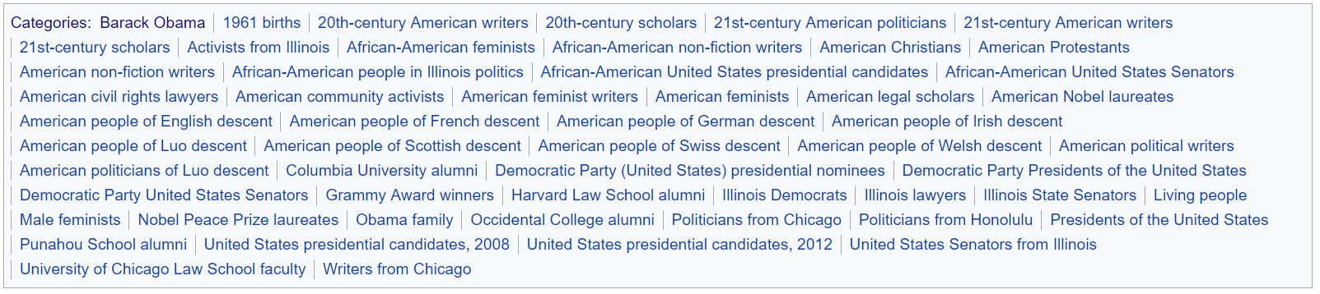
Wikipedia Category
Natural Language - obstacle of detecting trivia
Wikipedia also has structured information
Categories: set of articles with a shared topic

Slide 5
Wikipedia Category
Rank these categories by how trivia-worthy they are
Challenge: Formalize notion of trivia-worthy

Slide 6
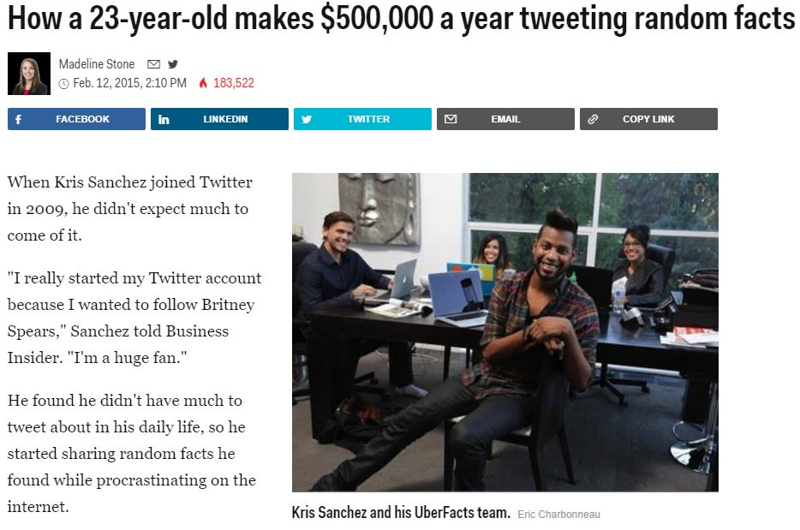

Slide 7
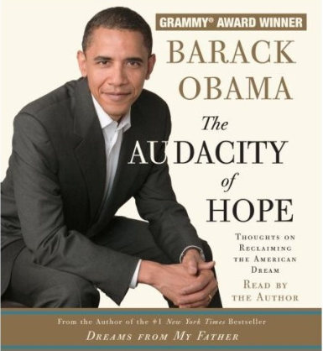
Not All Facts Are Trivia
Obama was a US president
Obama was born in 1961
Obama won a Grammy award

Slide 8
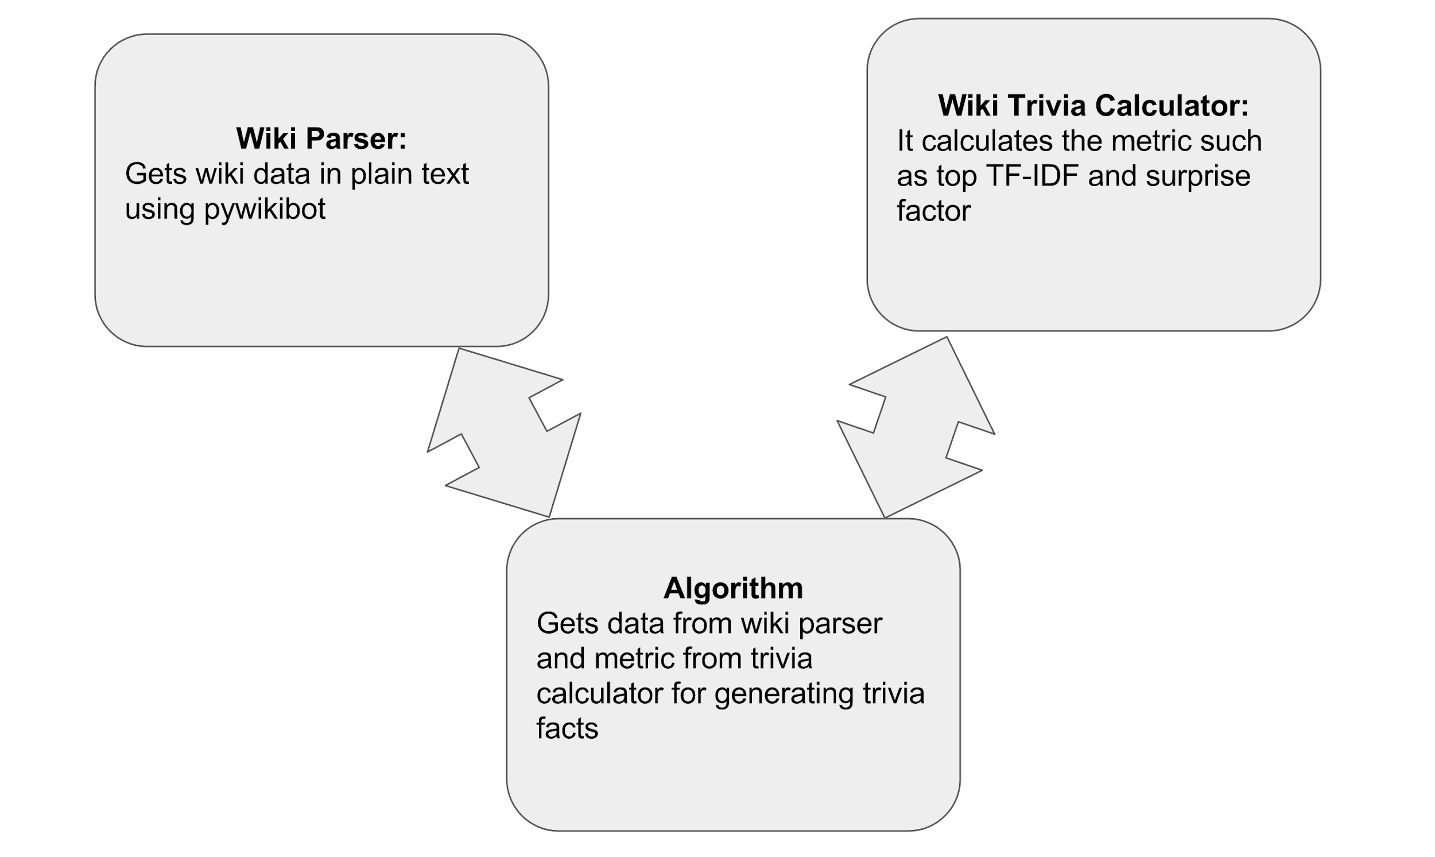
Architecture

Slide 9



Trivia Worthy
Surprise: get people’s attention
Cohesiveness
Trivia Worthy
Notes:
The first factor we consider is surprise. Since a category is a collection of articles, our main building block will be a similarity between articles. We denote article-article similarity by sigma a and a bar. A category C is a set of articles. We dene the similarity between an article and a category C as the average similarity between a and the articles of C
Because surprise measures how unusual it is for a given article to belong to a category, we define surprise as the inverse of the average similarity.
However, if we only consider surprise, very rare categories may rank high and we may obtain arbitrary details.
So we define the second factor cohesiveness, that is the average similarities between all pairs of articles in a category. But if we only consider cohesiveness, we may obtain some common facts that everyone knows.
So it’s better to choose the multiplication of these two factors to evaluate the worth of a trivia fact.

Slide 10
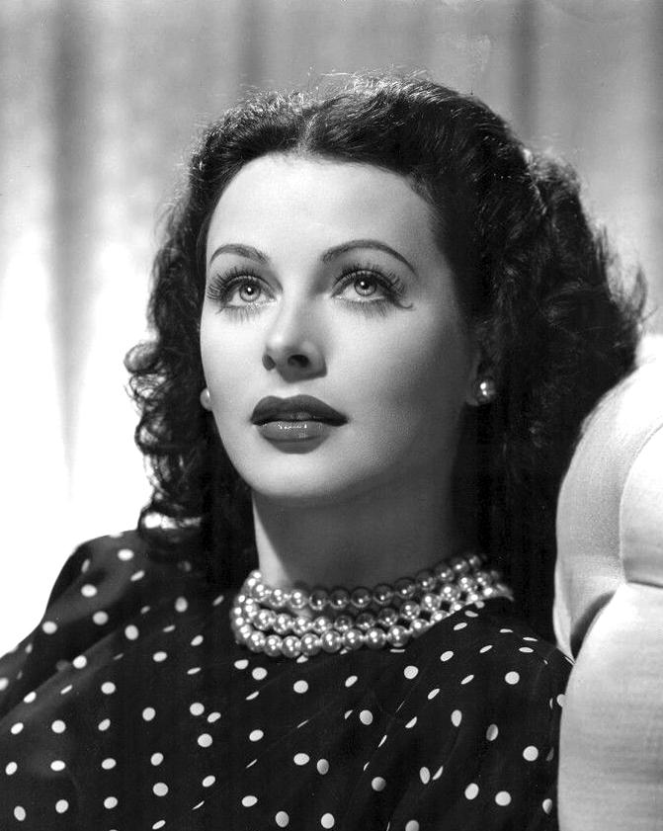
Top Surprise:
20th-century Austrian people
Women in technology
Radio pioneers
American anti-fascists
American people of Hungarian-Jewish descent
Top Cohesiveness:
Metro-Goldwyn-Mayer contract players
Actresses from Vienna
Austrian film actresses
20th-century Austrian actresses
American film actresses
Notes:
For example, consider 1940s Hollywood film actress Hedy Lamarr.

Slide 11
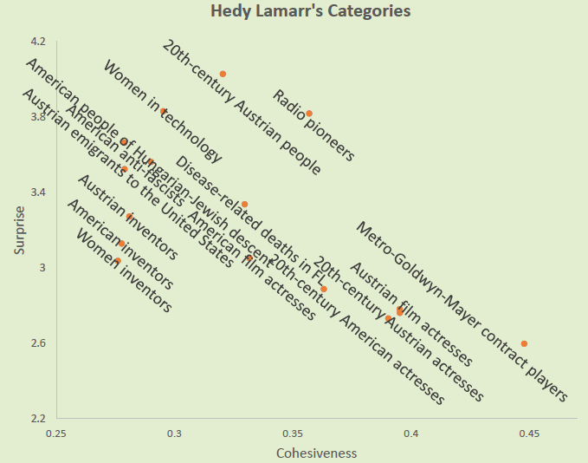
Notes:
Some arbitrary details like women inventors, it is actually surprise, but we may not care. Also like Metro-Goldwyn-Mayer contract players, that is so common, just like Obama is the President of United States.

Slide 12
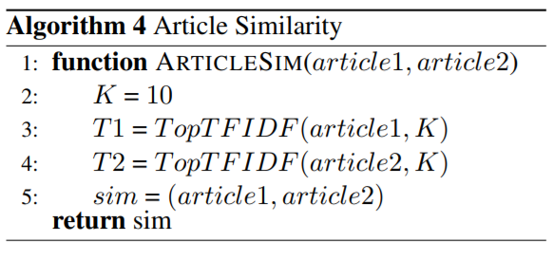
Algorithm
Notes:
First of all, we need to calculate the article similarity. If would be time consuming if we consider every word in a article. We only select 10 words in each article based on the TFIDF value. Also, we consider the semantic similarity between words.

Slide 13
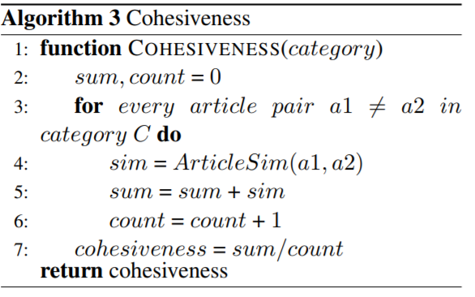
Algorithm

Slide 14
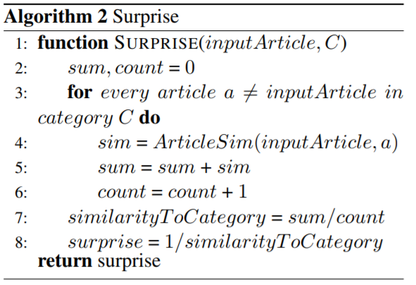
Algorithm

Slide 15
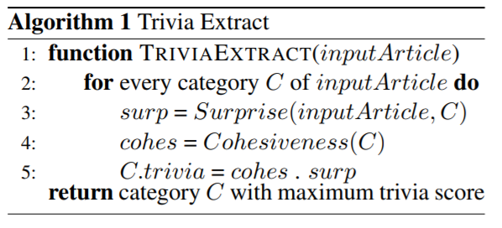
Algorithm

Slide 16
Result: Barack Obama for example
Punahou School alumni | 1.3387910646917047
Grammy Award winners | 1.2859668279303453
American Nobel laureates | 1.2565331843053882
Nobel Peace Prize laureates | 1.1786827577086749
American feminist writers | 1.1551973277907599
African-American feminists | 1.1167987835685782
American feminists | 1.0896562059932569
21st-century American politicians | 1.0057797842693141
Democratic Party United States Senators | 0.99517280067274383
Harvard Law School alumni | 0.994574666360582

Slide 17
Evaluation
Wikipedia Trivia Miner (WTM, IJCAI ‘15)
Compared top 5 (Didn’t get 100% overlap)
Due to randomly sampling ‘k’ entities for a category
Best Way - Run user studies (Not done due to lack of time/resources)

Slide 18
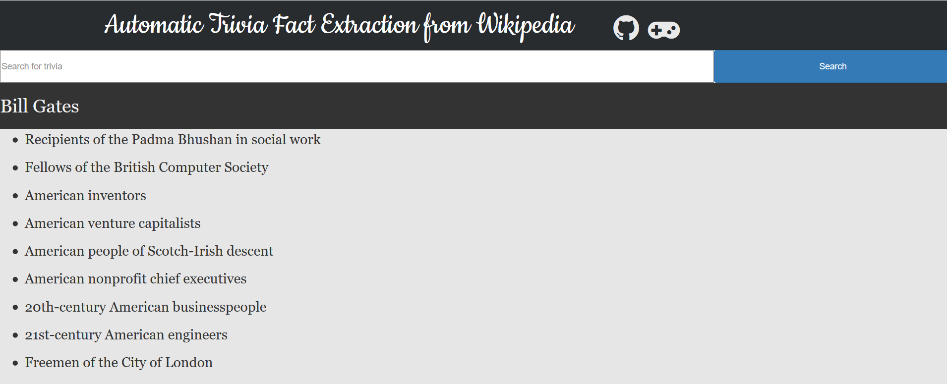
App!

Slide 19
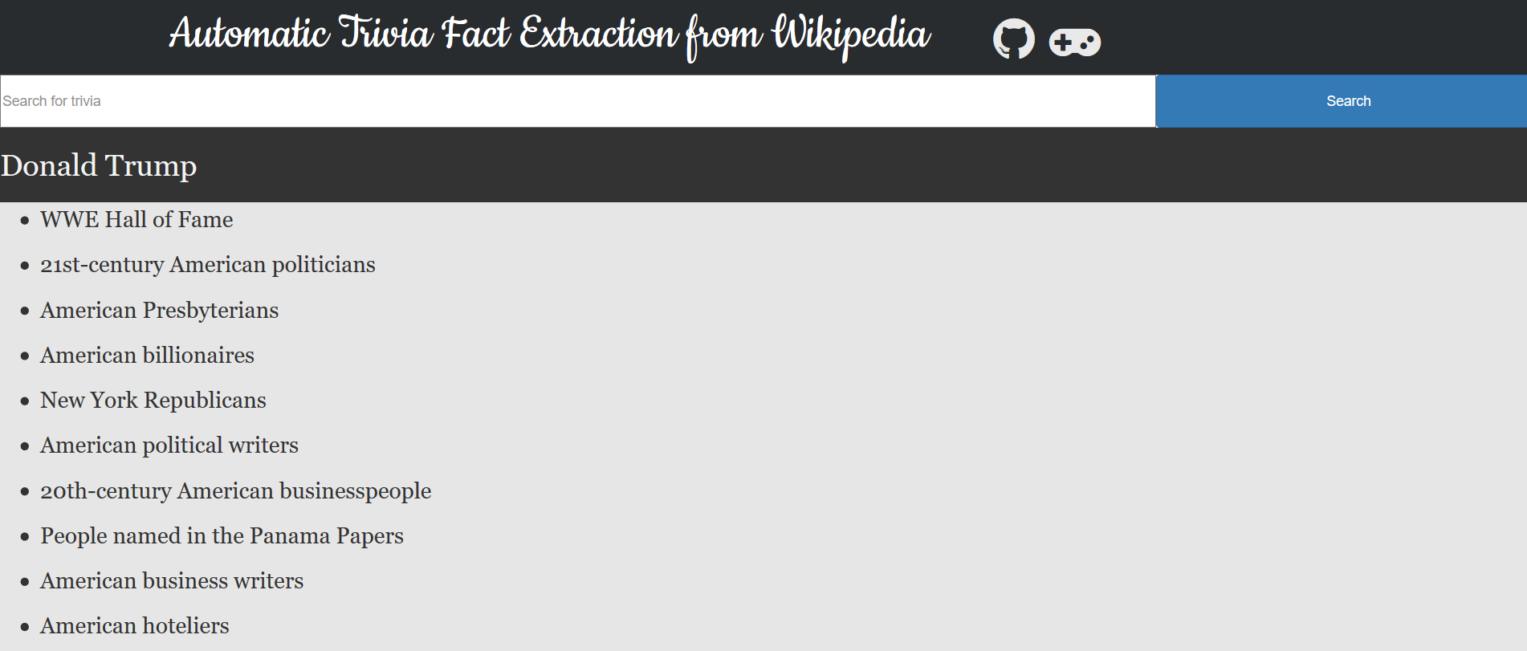
App!

Slide 20
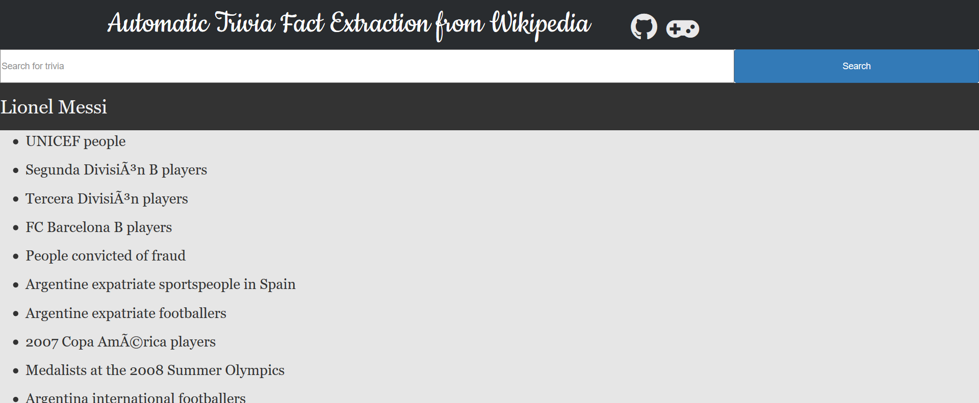
App!

Slide 21
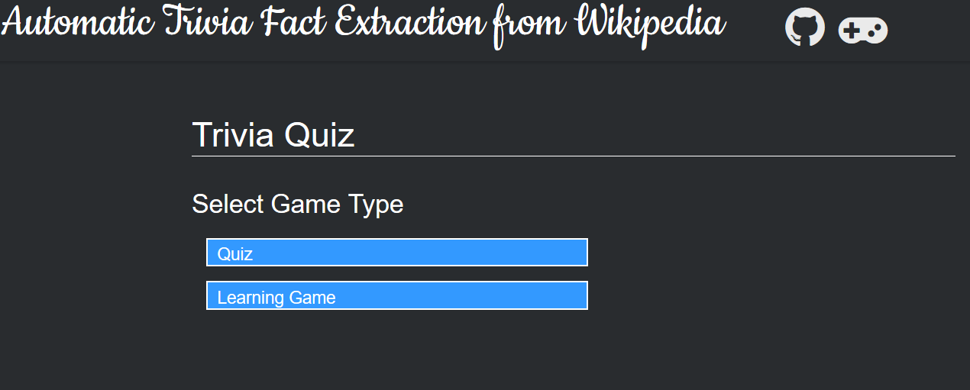
App!

Slide 22
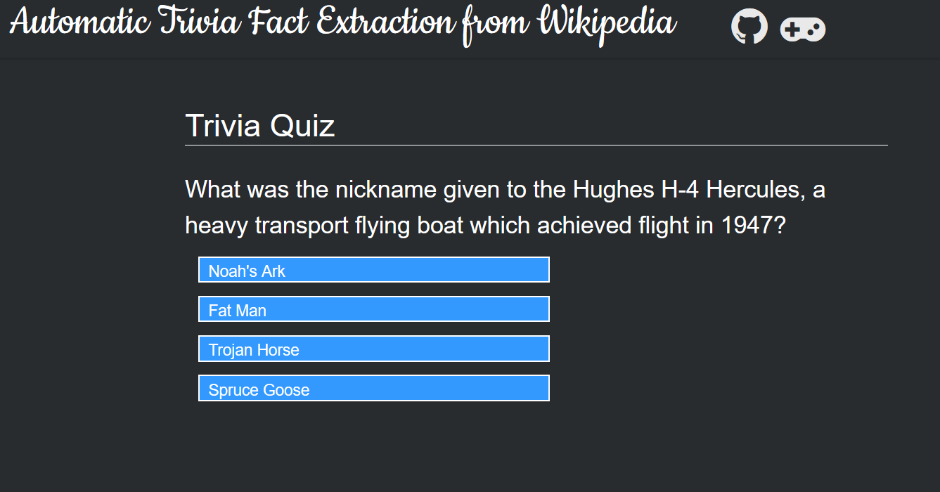
App!

Slide 23
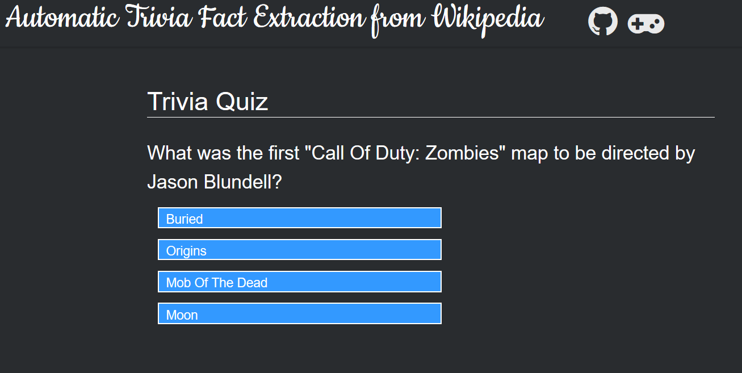
App!

Slide 24
Conclusion
Detect good trivia
Introduced formulation: Surprise, cohesiveness
Increase user engagement

Slide 25
References
Mika, Peter. "Entity search on the web." Proceedings of the 22nd International Conference on World Wide Web. ACM, 2013.
Tsurel, D., Pelleg, D., Guy, I., Shahaf, D.: Fun facts: automatic trivia fact extraction from wikipedia (2016). arXiv preprint arXiv:1612.03896
Yin, Xiaoxin, and Sarthak Shah. "Building taxonomy of web search intents for name entity queries." Proceedings of the 19th international conference on World wide web. ACM, 2010.
Sergey Chernov, Tereza Iofciu, Wolfgang Nejdl, and Xuan Zhou. Extracting semantics relationships between Wikipedia categories. SemWiki, 206, 2006.
Abhay Prakash, Manoj K. Chinnakotla, Dhaval Patel, and Puneet Garg. Did you know?: Mining interesting trivia for entities from wikipedia. In Proceedings of the 24th International Conference on Artificial Intelligence, IJCAI'15, pages 3164--3170. AAAI Press, 2015.

Slide 26
References
Matthew Merzbacher. Automatic generation of trivia questions. In International Symposium on Methodologies for Intelligent Systems, pages 123-130.Springer, 2002.
Marco Baroni, Georgiana Dinu, and Germ ́an Kruszewski. Don’t count, predict! a systematic comparison of context-counting vs. context-predicting semantic vectors. In Proceedings of Association for Computational Linguistics (ACL), volume 1, 2014.
Tom Kenter and Maarten de Rijke. Short text similarity with word embeddings. In Proceedings of the 4th ACM International on Conference on 353 Information and Knowledge Management, CIKM ’15, pages 1411–1420, New York, NY, USA, 2015. ACM.
Tom Kenter and Maarten de Rijke. Short text similarity with word embeddings. In Proceedings of the 4th ACM International on Conference on 353 Information and Knowledge Management, CIKM ’15, pages 1411–1420, New York, NY, USA, 2015. ACM.

